Slide 1
“On the Shoulders of Giants”
The Cervical Spine Research Society
The Early Years
Edward J. Dunn, MD

Slide 2
Standing on the Shoulders of Giants
Discovering truth by building on previous work and discoveries
Isaac Newton writing to Robert Hooke
February 1676
“If I have seen further, it is by standing on the shoulders of giants”

Slide 3
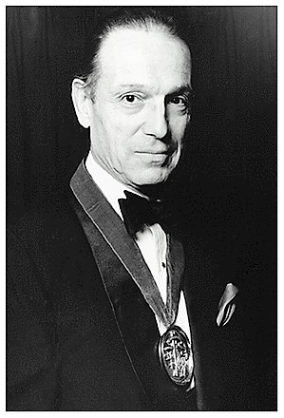
J. William Fielding, MD
Originator

Slide 4
J. William Fielding, MD
CSRS-his idea
Cinematography of odontoid fractures
Elaborate presentations, four projectors, two screens, lap dissolve
International contacts
Always helping, offering criticism and advice, never really taking any credit

Slide 5
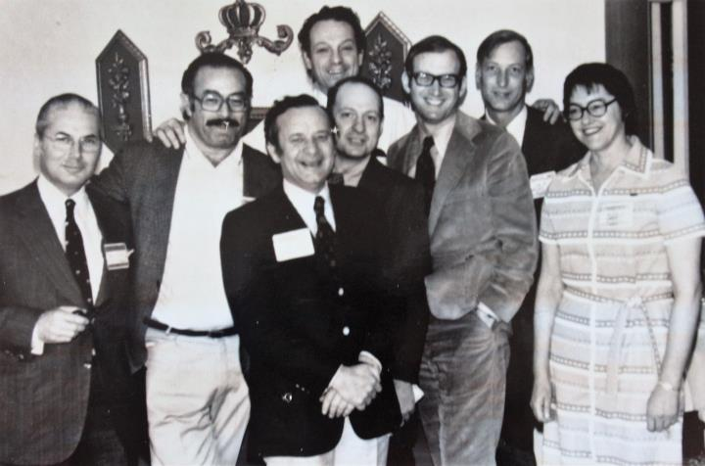
C.S.R.S. Organizers-A.A.O.S. 1973
Simmons, Jacobs, Macnab, Sherk, Fielding, Rothman, Riley, Garret

Slide 6
Founding Members
N.Y.C. December 1973
Robert Bailey, Henry Bohlman, Edward Dunn, J. William Fielding, Alice Garret, Ashby Grantham, Robert Hensinger, Mason Hohl, Bernard Jacobs, Henry Larocca, Donlin Long, Ian MacNab, Wesley Park, Joseph Ransohoff, Lee Riley, Robert Robinson, Richard Rothman, Henry Sherk, Edward Simmons, Wayne Southwick, Shannon Stauffer, Augustus White, Thomas Whitesides

Slide 7
The Cervical Spine Research Society
Purpose - exchange and development of ideas and philosophy regarding the diagnosis and treatment of cervical spine injury and disease.
International participation encouraged
Multidisciplinary
Membership- meeting presentation, demonstrated interest in C spine

Slide 8
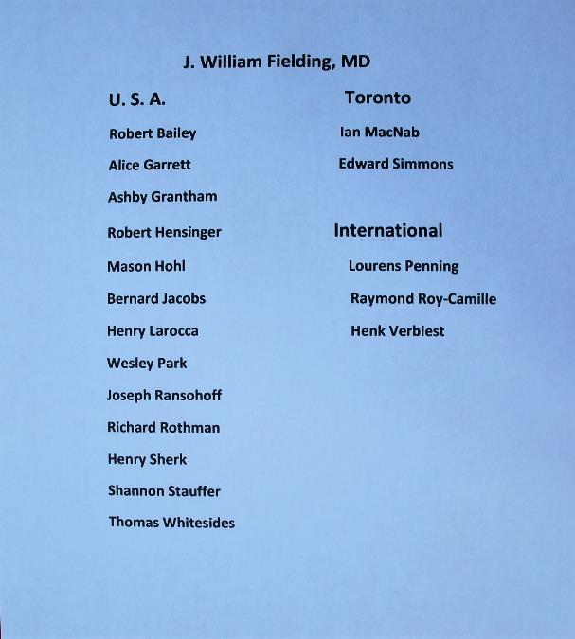

Slide 9
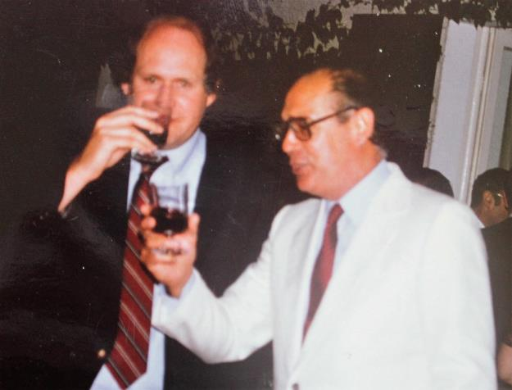
Raymond Roy-Camille, MD

Slide 10
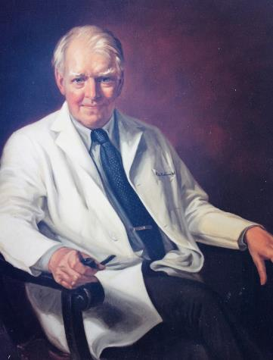
Robert A. Robinson, MD

Slide 11
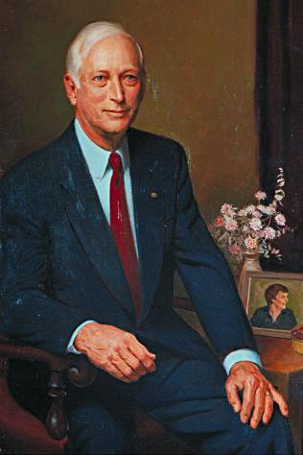
Lee H. Riley Jr. MD IV

Slide 12
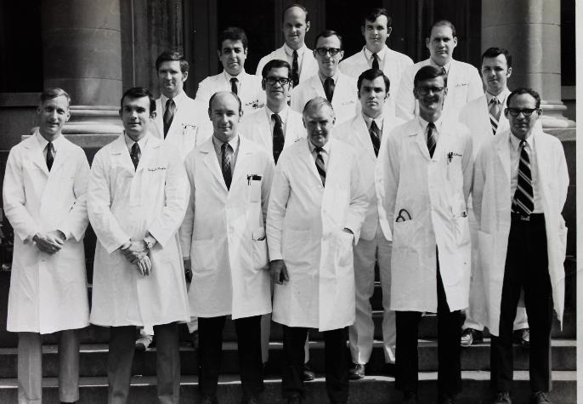
Johns Hopkins 1969
Residents and Staff

Slide 13
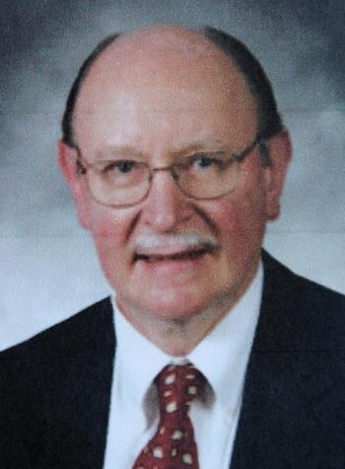
Henry H. Bohlman, MD XVII

Slide 14
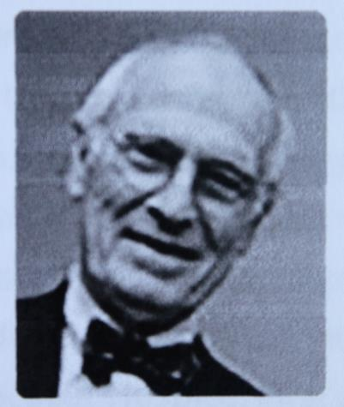
Wayne Southwick, MD

Slide 15
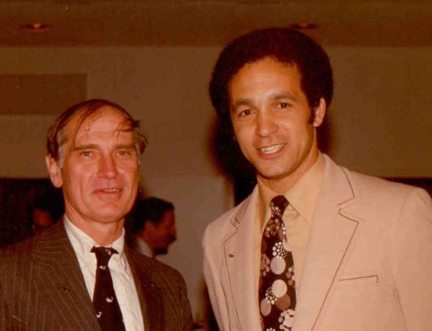
Wayne Southwick MD
Augustus A. White III MD

Slide 16
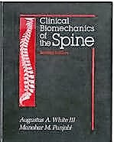
Research

Slide 17
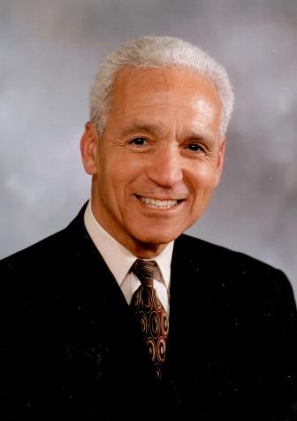
Augustus A. White III-XVI

Slide 18
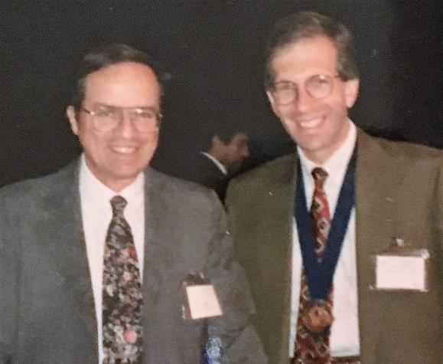
Charles R. Clark, MD XX
Joseph S. Barr Jr. MD XXI

Slide 19
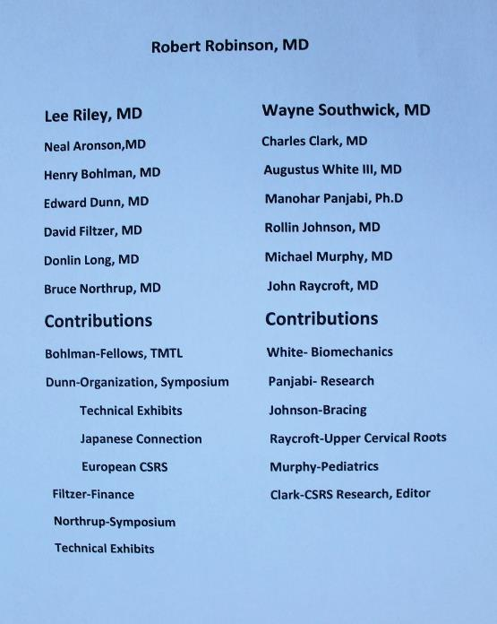

Slide 20
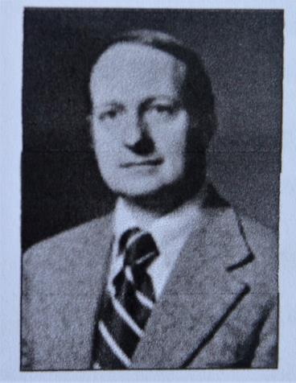
Henry H. Sherk, MD XI

Slide 21
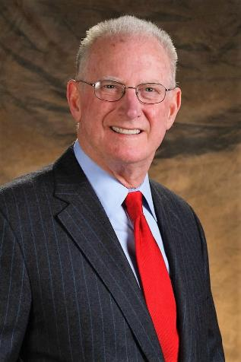
Richard H. Rothman, MD V

Slide 22
Toronto Connection
J. William Fielding-Founder, President-1973, 1974
Ian MacNab-Early contributor, acceleration injuries, spondylosis
Edward Simmons-Osteotomy correction of flexion deformities
Logo of CSRS
President-1975

Slide 23
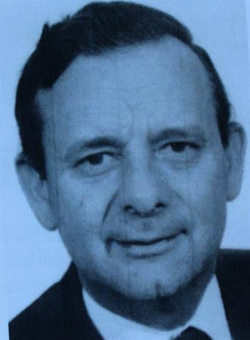
Ian Macnab, MD

Slide 24
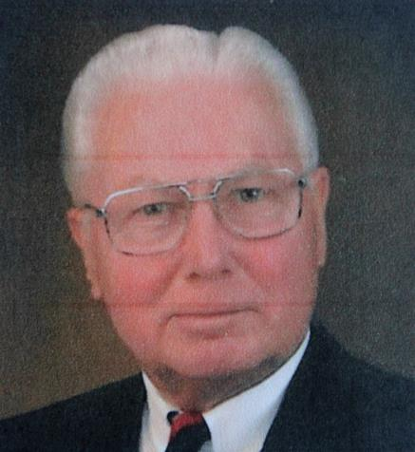
Edward H. Simmons, MD III

Slide 25
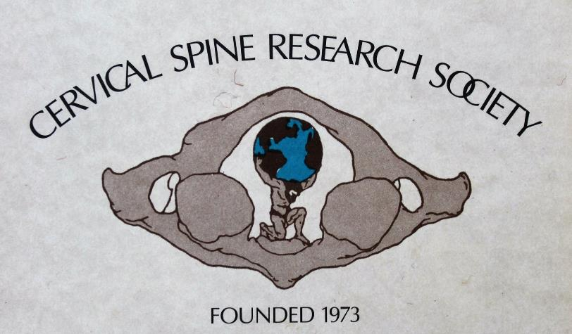
Logo Introduced Toronto-1975

Slide 26
Henry Larocca, MD
Founder and 1st Editor Journal Spine
First Director CSRS Instructional Course
Founding Member CSRS
XIX President CSRS
Introduced Thomas Whitecloud XIV
to CSRS

Slide 27
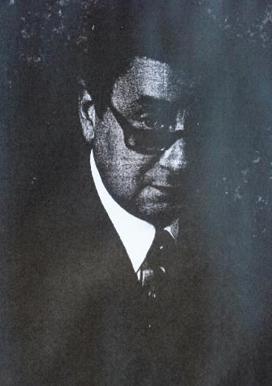
Henry Larocca, MD

Slide 28
Michigan Connection
Robert Bailey MD-President 1979
Arguably first anterior surgery of cervical spine-tumor
Proposed idea of book The Cervical Spine-1979
Robert Hensinger-Enthusiastic early member-Cervical Spine Problems in Children-Conflicts with other meetings

Slide 29
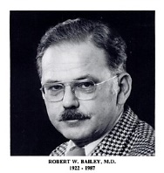
Robert W. Bailey, MD VII

Slide 30
Rancho Los Amigos
Alice Garrett, MD
Rehabilitation
President, Treasurer CSRS
E. Shannon Stauffer, MD
Spinal Cord Injury
Rehabilitation
President, Treasurer CSRS

Slide 31
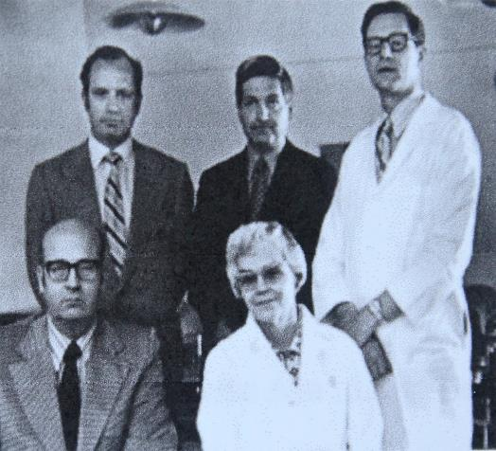
E. Shannon Stauffer, MD

Slide 32
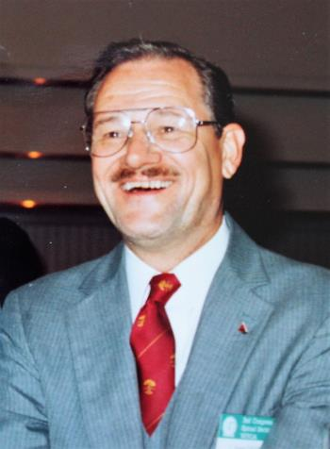
E. Shannon Stauffer XIII

Slide 33
Early Neurosurgical Contributors
Joseph Epstein-President 1982
Posterior approach, spondylosis, disc herniation-instrument designer-Course
Richard Raynor-President 1987
Arnold Chiari-posterior approach
Joseph Ransohoff, Sanford Larson-President 1990-Spinal Cord Injury
Henk Verbiest-Tumors

Slide 34
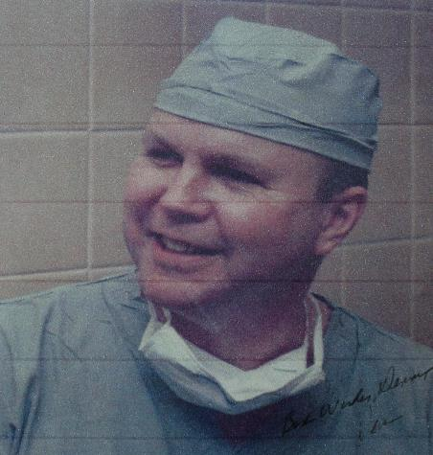
Sanford J. Larson, MD XVIII

Slide 35
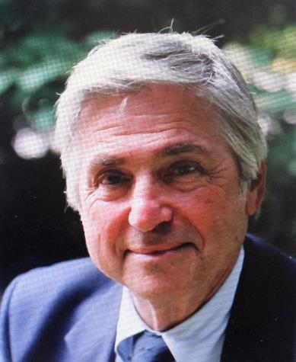
Joseph A. Epstein, MD X

Slide 36
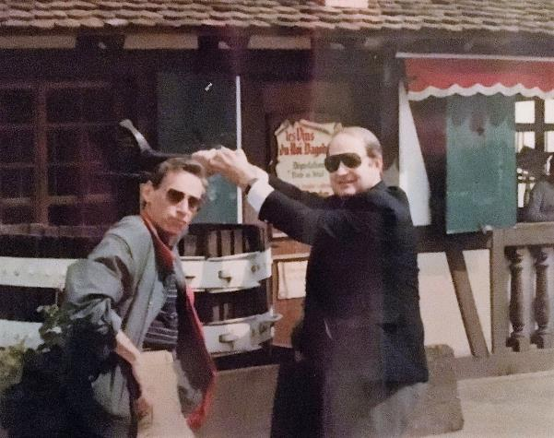
Henry H. Sherk, MD XI
Richard B. Raynor, MD XV

Slide 37
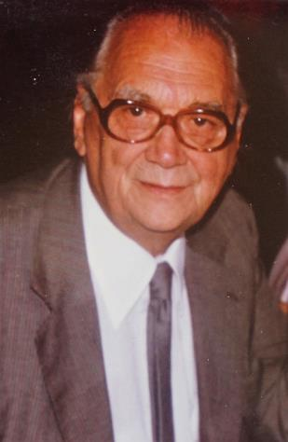
Henk Verbiest, MD

Slide 38
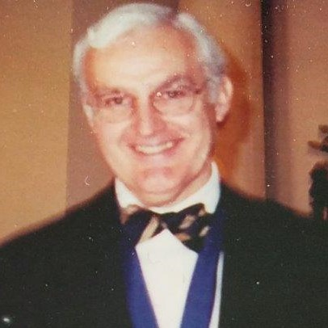
Bruce Northrup, MD XXV

Slide 39
CSRS-1976-Philadelphia
A Breakthrough Meeting!
Symposium-Cervical Spondylotic Myelopathy
OPLL-Japanese Connection
Technical Exhibits
Publication symposium, abstracts in the journal Spine

Slide 40
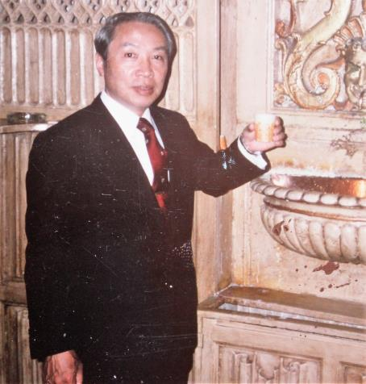
Keiro Ono, MD

Slide 41
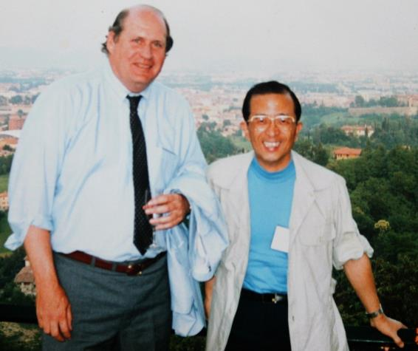
Kiyoshi Hirabayashi, MD
Edward J. Dunn, MD

Slide 42
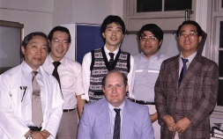
Osaka University

Slide 43
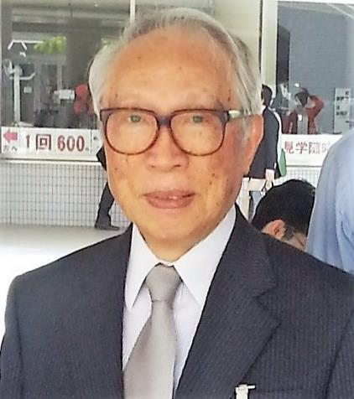
Professor Keiro Ono
Osaka University

Slide 44
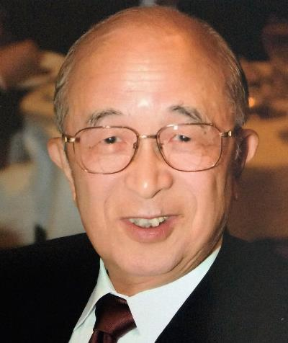
Professor Kiyoshi Hirabayashi

Slide 45
European Section CSRS
1980-Palm Beach-Edward Dunn, Pres.
Prof. Mario Boni, Pavia, Italy, 1st Mtg.
Impressed by openness of discussion
Suggested European Section
Much Discussion, Founding Philosophy
Arranged Trial C Spine Mtgs. Pavia
1983 European Section Founded at Osnabruck, Germany-Dr. Weidner host and chairman, Dr. Boni-President

Slide 46
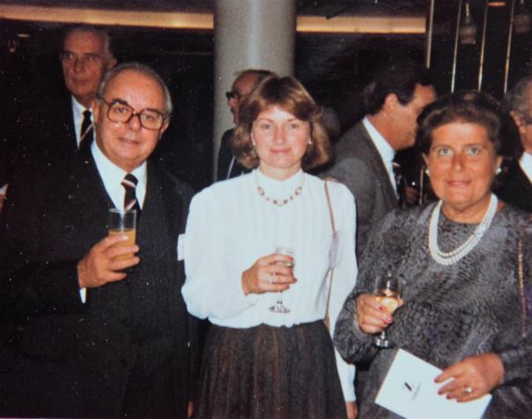
Dr. and Mrs. Mario Boni
Eleanor Dunn

Slide 47
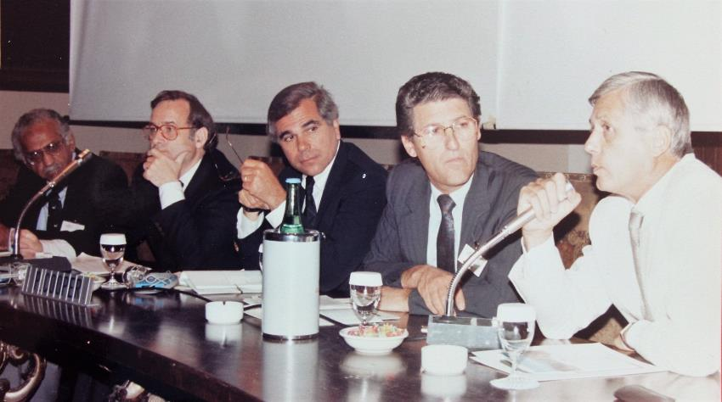
Panjabi, Weidner, Cooper, Louis,Logroscino

Slide 48
European Section CSRS
Embellished CSRS Reputation
Provided Forum for European Specialists
Fostered Attendance between US and Europe
Contributions-Too Many to List
History- Another Story

Slide 49
Founding Member Communication
CSRS
Robert Hensinger, Mason Hohl, Richard Rothman,Augustus White III, Thomas Whitesides
CSRS European Section
Carlo Logroscino, Andreas Weidner
*Collegiality

Slide 50
Founders’ Advice
Keep Open Floor Discussion
Keep Membership Requirements
Don’t Limit Membership
Remain a Forum for Discussion of New Ideas

Slide 51
Thanks
For the Opportunities I Have Had
For the Knowledge I Gained
For the Friends I Made

Slide 52
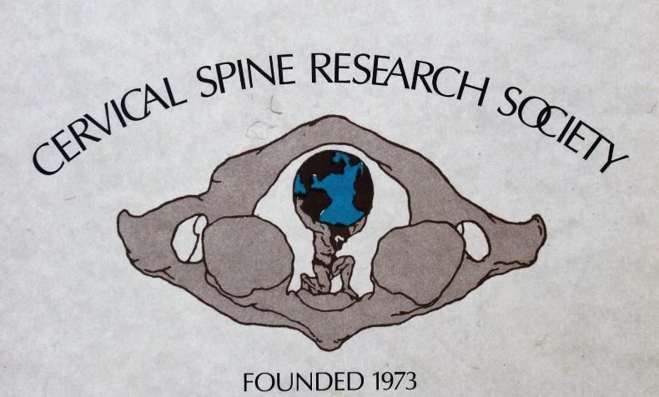

Slide 53
Apology
To those whose name wasn’t mentioned and those whose photo wasn’t shown.
Time constraints and the availability of photos were limiting factors.

Slide 54

Collecting Photos
Pulling Teeth from a Polar Bear

Slide 55
Photo-Contributors
Chesney Archives-Johns Hopkins Hosp.
Charles Clark, MD
CSRS Archives
Joseph Cusack, MD
Nancy Epstein, MD
Robert Hensinger, MD
Louis Jenis, MD
Carlo Logroscino. MD

Slide 56
Photo-Contributors
Paul Mc Afee, MD
Dr and Mrs. Bruce Northrup
Richard Rothman, MD
Mrs. Henry Sherk
Andreas Weidner, MD
Augustus White III, MD
Kazuo Yonenobu, MD

Slide 58
Henry Longfellow
A Lesson on Life and Aging
“ For age is opportunity no less than youth itself, though in another dress.
As the evening twilight fades away, the sky is filled with stars, invisible by day.”

Slide 59
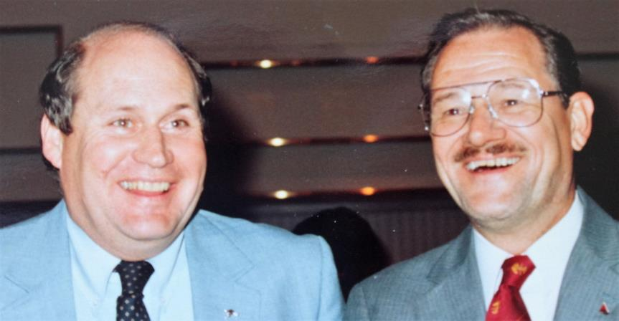
E. Shannon Stauffer, MD XIII
Edward J. Dunn, MD VIII

Slide 60
Additional Milestones
1983-First Publication of The Cervical Spine-Henry H. Sherk, MD-Editor
1983-First CSRS Instructional Course
Henry Larocca, MD-Director

Slide 62
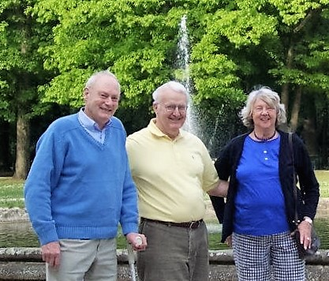
Dr and Mrs. Dieter Hohmann
Bruce Northrup, MD

Slide 63
Photo-Contribitors

Slide 64
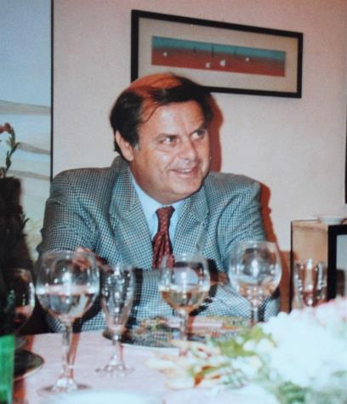

Slide 65
Complications of C-Spine Surgery
Jacob J. Graham, MD-Spine 1989
Five Year Report on Survey of Membership
Listed complications
No denominator
Helpful in malpractice defense

Slide 66
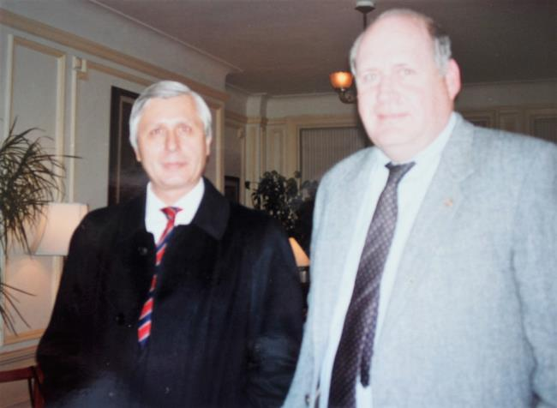
Carlo Logroscino, MD

Slide 67
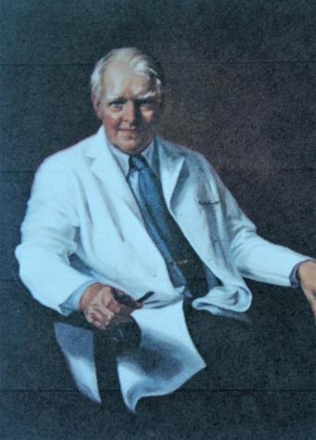
Robert A. Robinson, MD

Slide 68
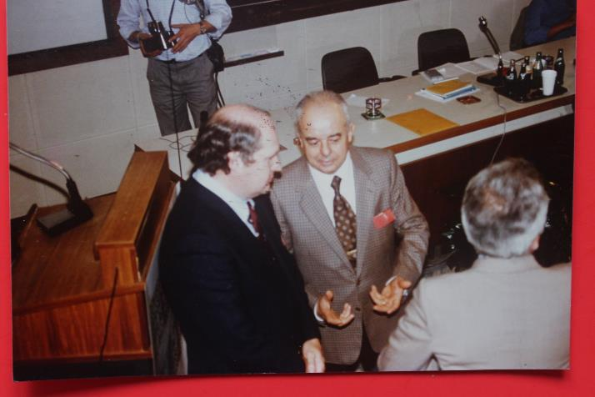
Mario Boni, MD

Slide 69
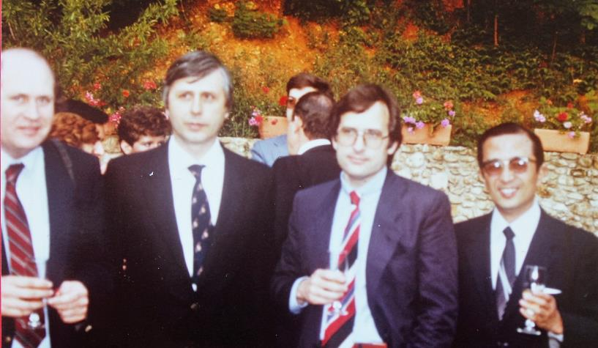
Dunn, Logroscino, Weidner, Hirabayashi

Slide 70
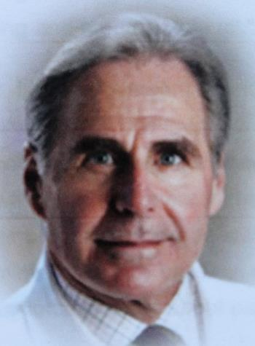
Harry H. Herkowitz, MD

Slide 71
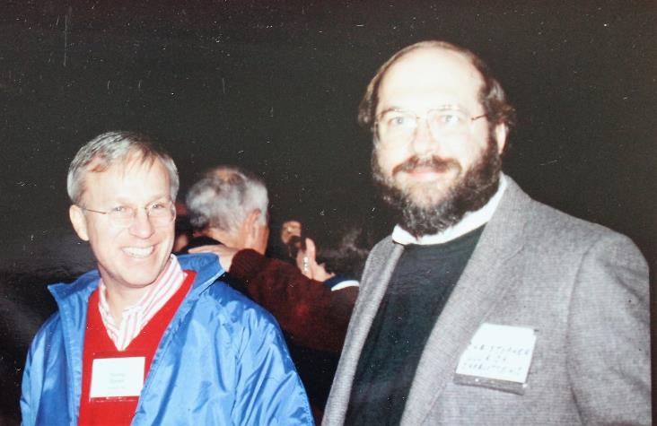
Thomas Ducker, MD XXII
Christopher Ullrich, MD XXVIII

Slide 72
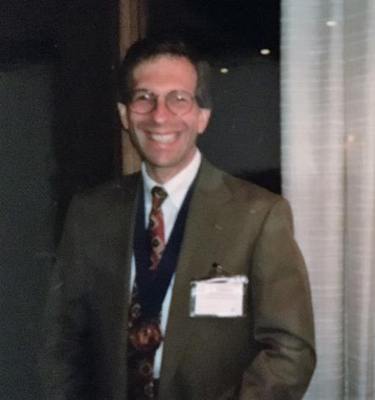
Charles R. Clark, MD XX

Slide 73
CSRS Keys to Success
Organization
Membership
Multidisciplinary
Venues
Education-annual meeting, free discussion, book, courses, exhibits
Finances
Affiliated sections, European, Pan-Pacific
Collegiality

Slide 74
European Section CSRS
Too many contributions and contributors to list fully
Mention-Lourens Penning-Radiology
Henk Verbiest-Tumors, Andreas Weidner, Dieter Grob, Fritz Magerl-Anterior Plating, Raymond Roy-Camille-Posterior Plating, Fritz Magerl, Dieter Grob-

Slide 75
Photo-Contributors
Chesney Archives, Johns Hopkins Hospital
Charles Clark, MD
CSRS Archives
Joseph Cusack, MD
Nancy Epstein, MD
Robert Hensinger, MD
Carlo Logroscino, MD
Paul McAfee, MD
Dr. and Mrs. Bruce Northrup
Richard Rothman, MD

Slide 76
Robert A. Robinson, MD
Lee Riley, MD Wayne Southwick, MD

Slide 77
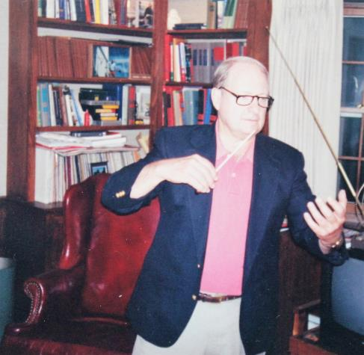
Henry H. Sherk, MD XI

Slide 78
Philadelphia
Henry H. Sherk, MD
1st Editor-The Cervical Spine-1983
Multiple Committees, Embryology
President, Secretary, CSRS
Richard H. Rothman, MD
President, Secretary CSRS
“Hanged Man Fracture”

Slide 79
The Japanese Connection
Sicot- Copenhagen-1975
Drs Ono and Dunn meet
Invited to 4th CSRS meeting, Philadelphia
Presented papers on OPLL and pathology of Cervical Spondylosis
Spectacular Reception!
Result, Dr. Hirabayashi –Laminoplasty & other contributions over the years

